Slide 1
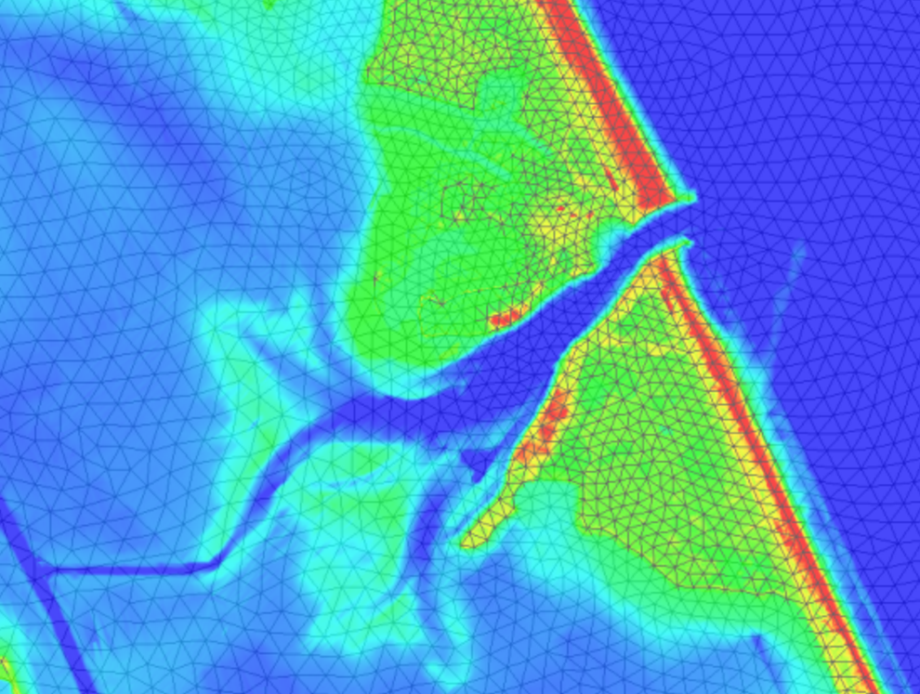
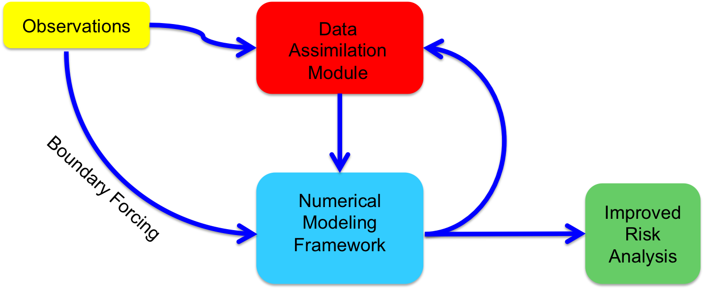

Remote assessment and short-term forecasting for the nearshore
Tyler Hesser
Matthew Farthing
Lee Jenkins
Coastal and Hydraulics Laboratory
US Army Engineer R&D Center
Clemson University
18 June 2017

Slide 2
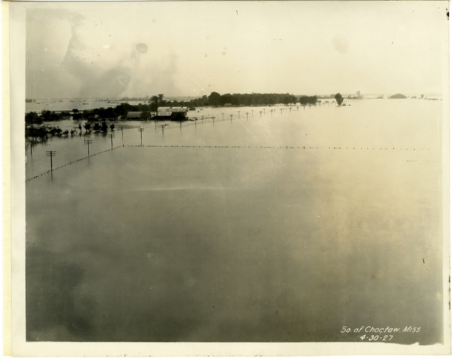
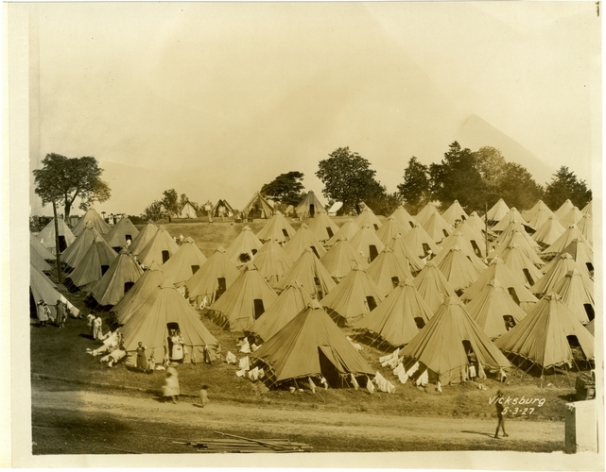
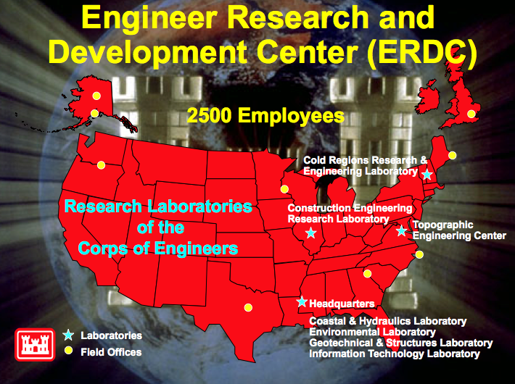
What is ERDC?
1930
Established by Congress as the
Waterways Experiment Station (WES)
Mississippi Delta, 1927
Vicksburg, 1927
Today
Applied R&D Organization for the Corps of Engineers, DoD
Civil Engineers, Physicists, Mathematicians, Anthropologists …

Slide 3
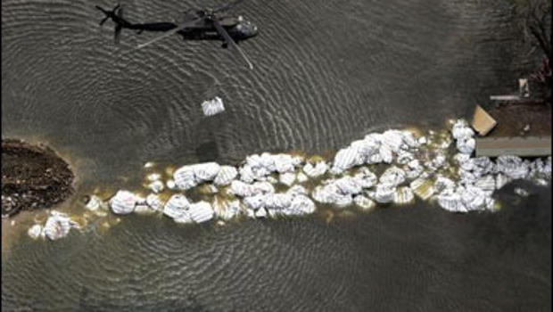
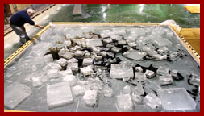
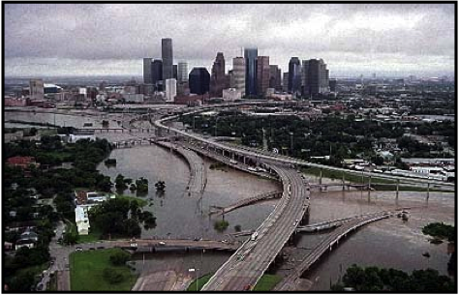
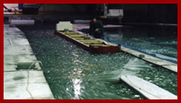
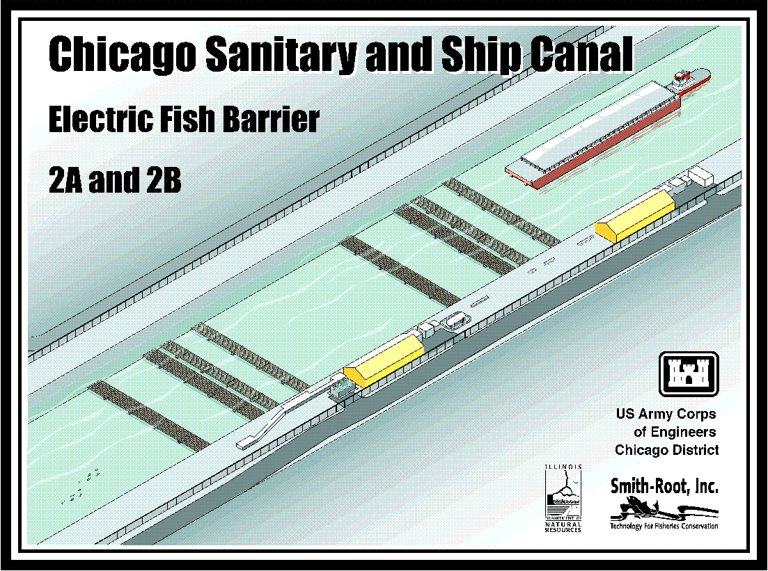
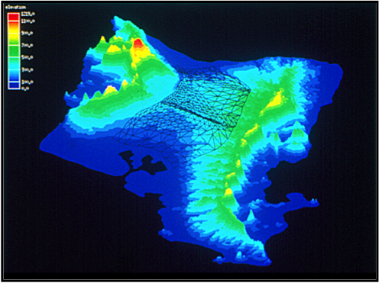
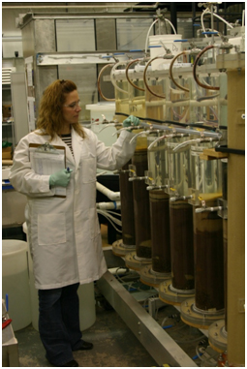
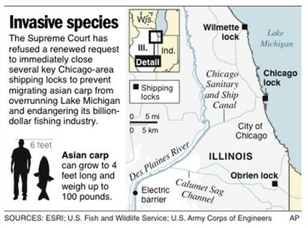
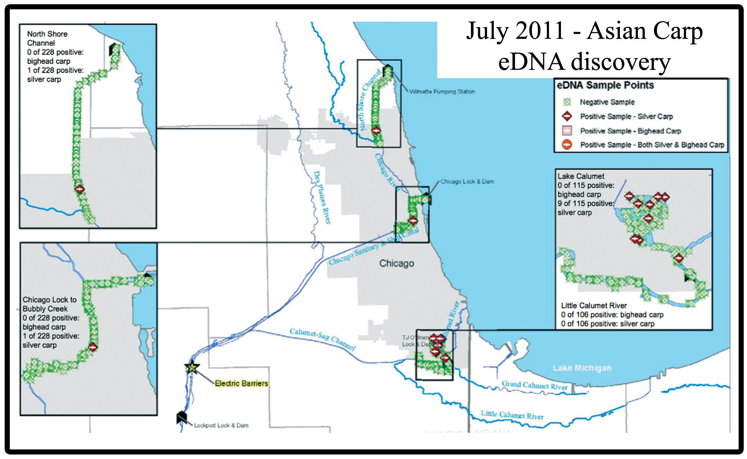
Civil Works Mission
Flood and Storm Damage Reduction and Dredging
Ice Hydraulics and Engineering
Environmental Contamination
Invasive Species

Slide 4
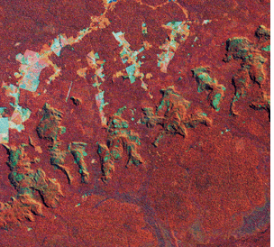
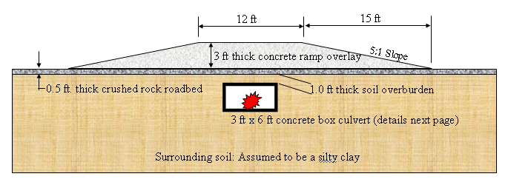
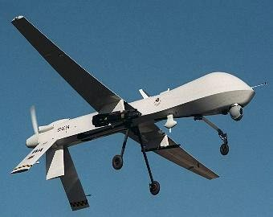
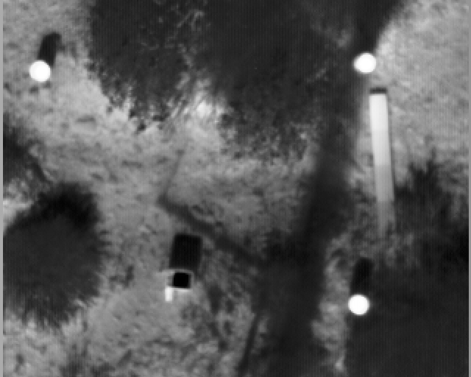
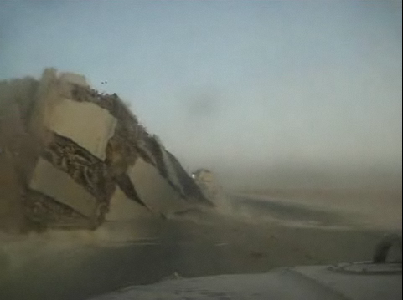
Military Applications
Force Protection
No Overlay
With Overlay
Remote Sensing for Threat Detection and Engineering Analysis
Notes:
Airborne or vehicle-mounted
Electro-optical, infrared, and radar are most common
Flightlines are 10s of meters by 1000s of meters – generates a lot of imagery
Automated target recognition (ATR) algorithms for image analysis

Slide 5
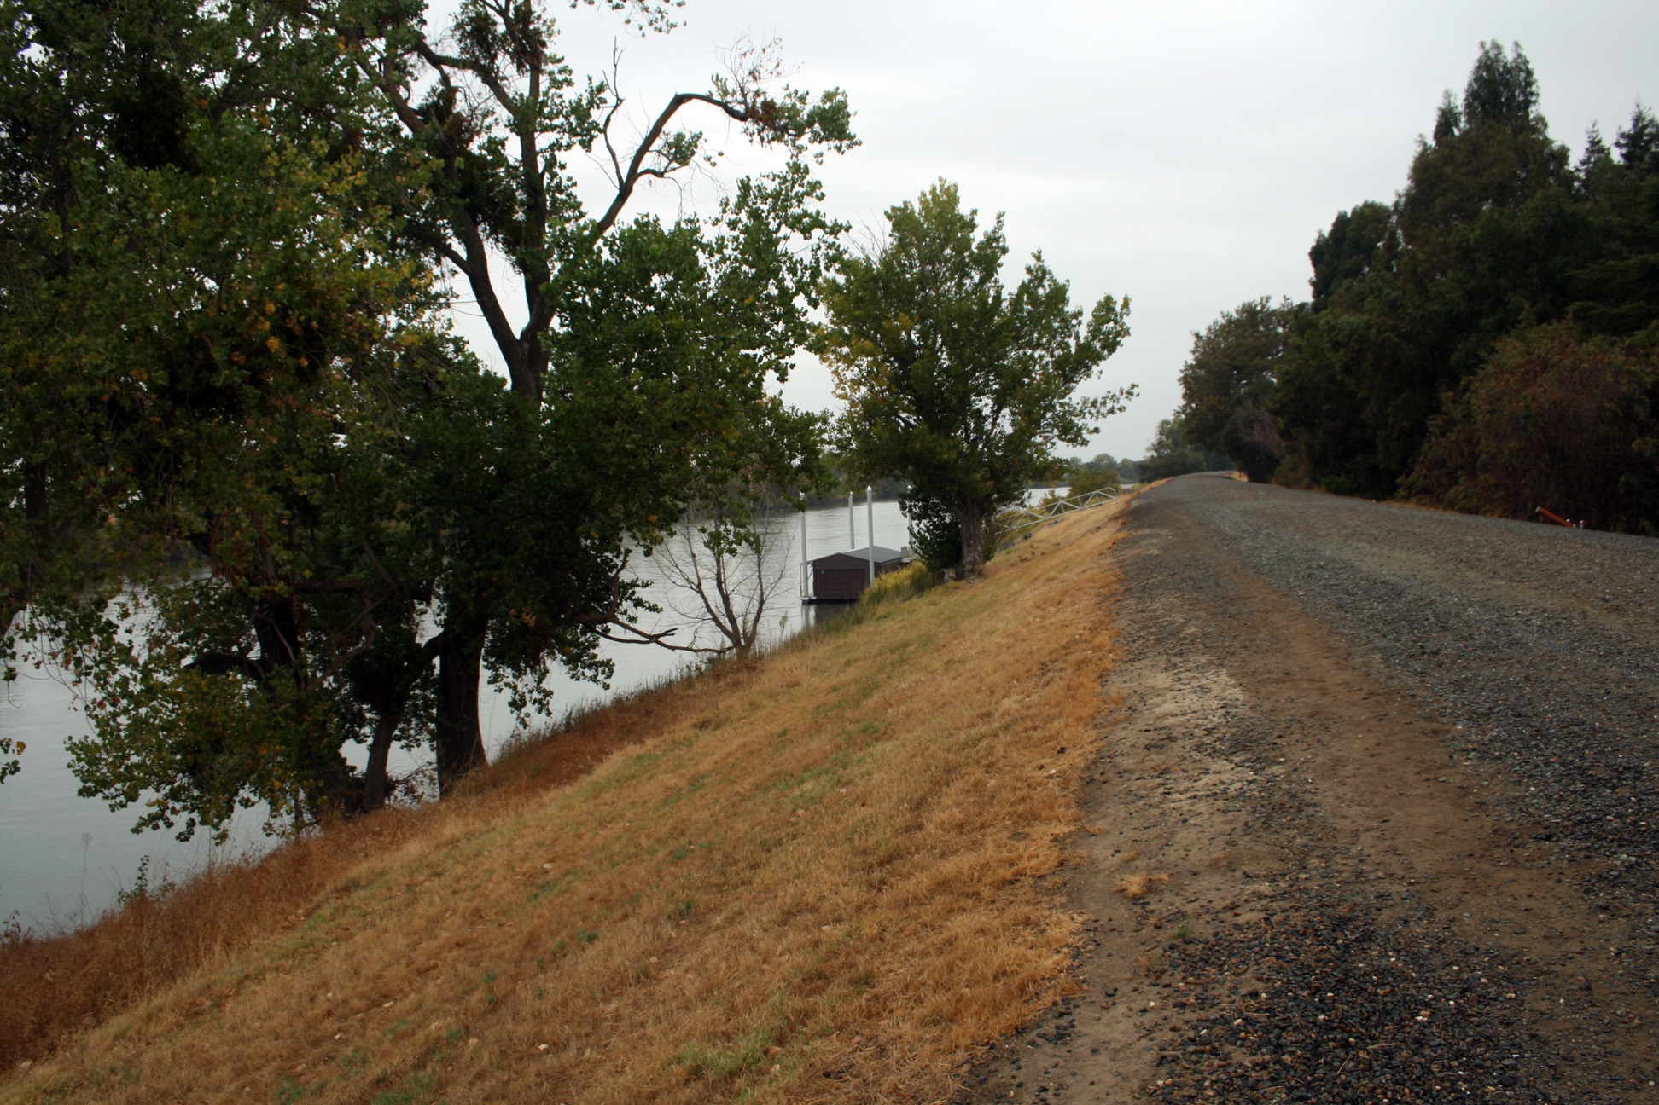
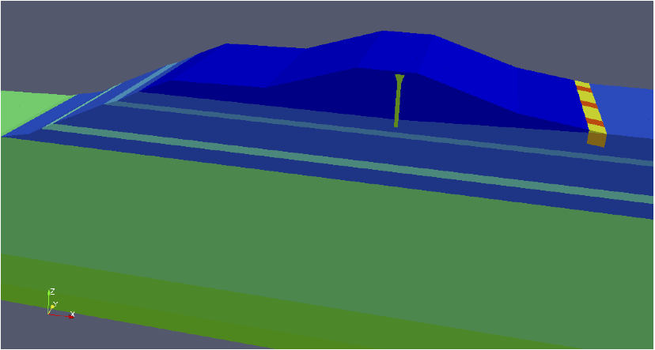
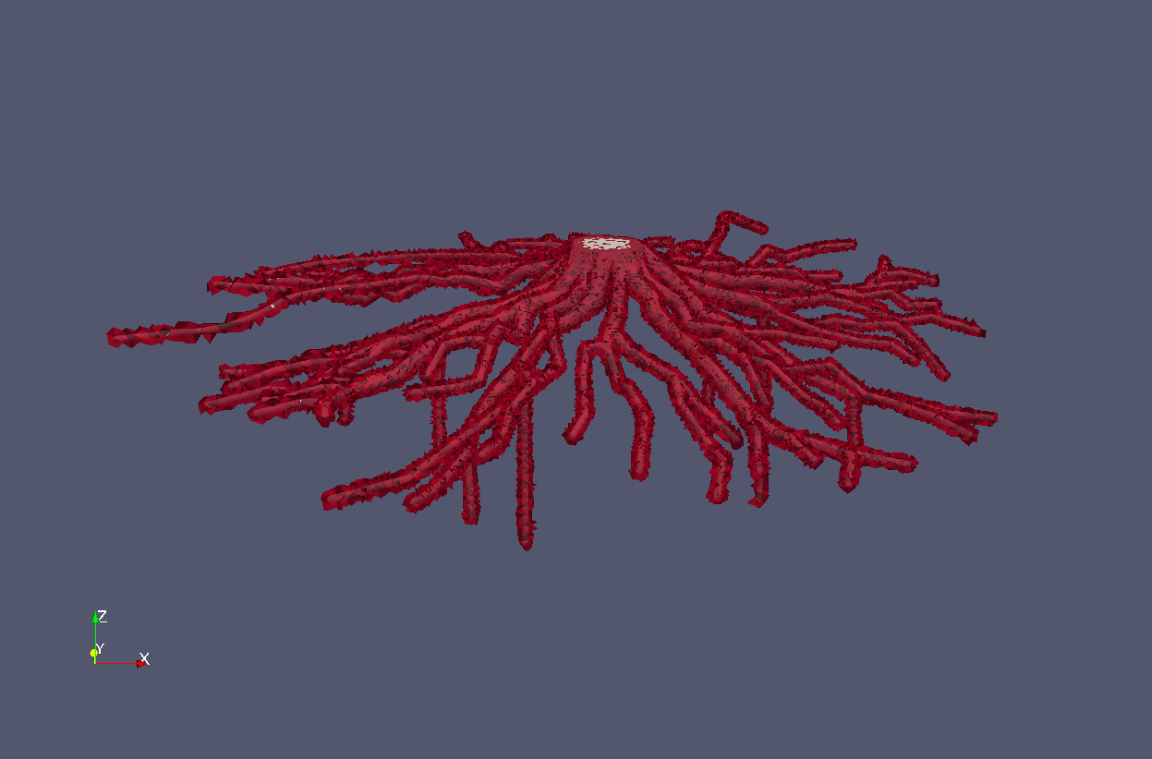
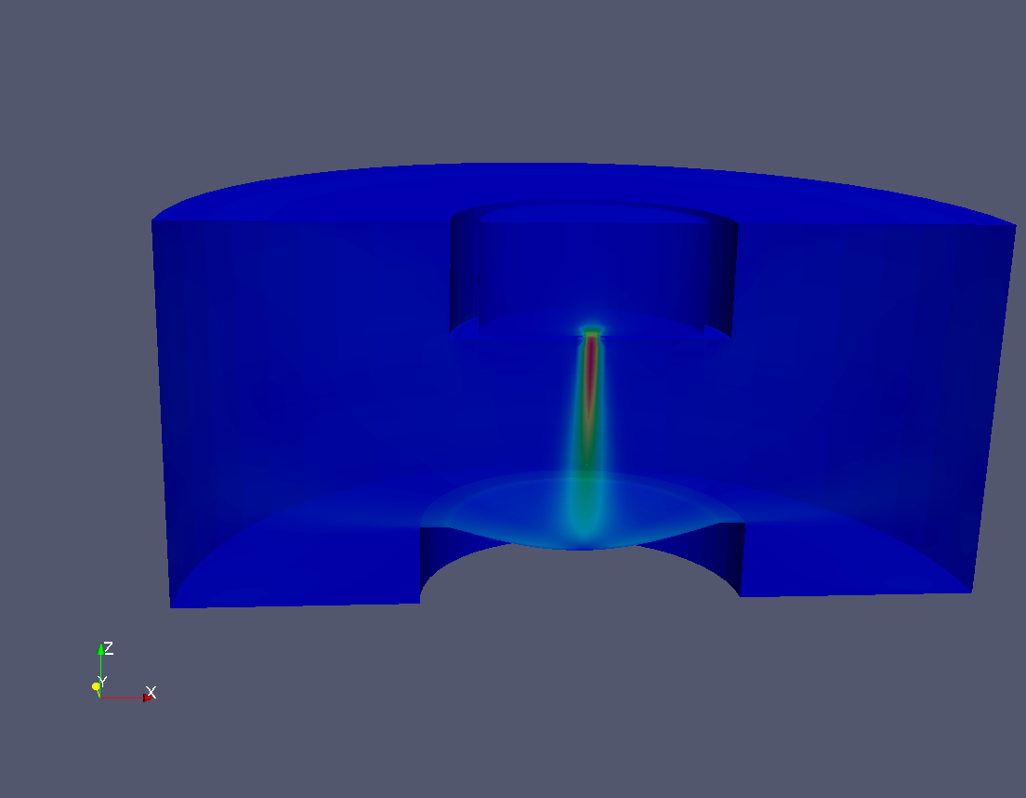
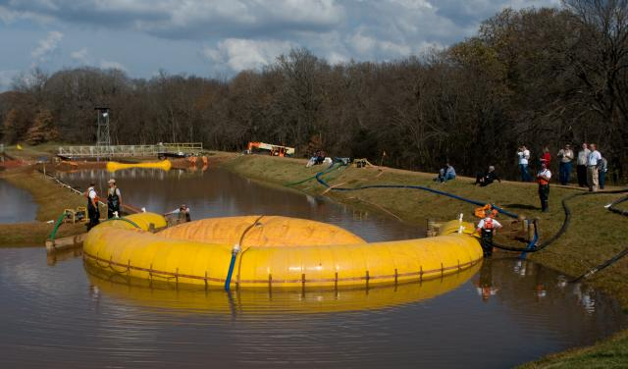
What do we have to offer?
Levee Safety and Protection
Large (and small) scale experimental facilities
HPC and computational modeling resources
Interesting Problems
Sacramento Pocket Levee
Pocket levee domain with periodic vegetation zone.
1:16 Scale Breach Model
Levee breach in Sacramento-San Joaquin River Delta
ERDC Full Scale Breach Test Facility
Lab-Scale Surface Erosion Testing
Notes:
Multiphysics simulation on km scale domains with localized cm scale resolution
Variably saturated subsurface flow
Nonlinear soil mechanics (elasto-plastic deformation)
Soil-root zone 167, 237 elements
Computational mesh ~15 million tetrahedral elements

Slide 6
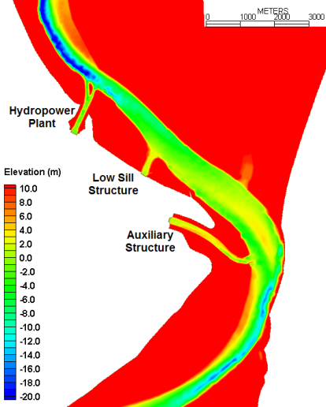
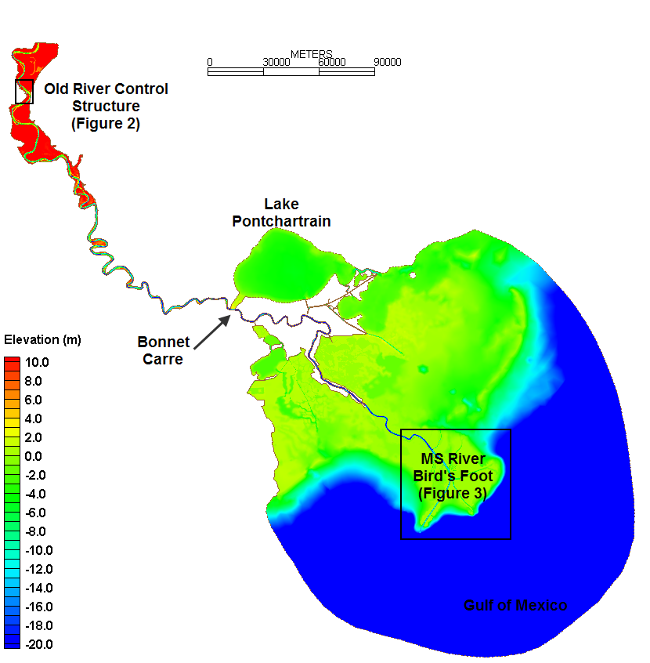
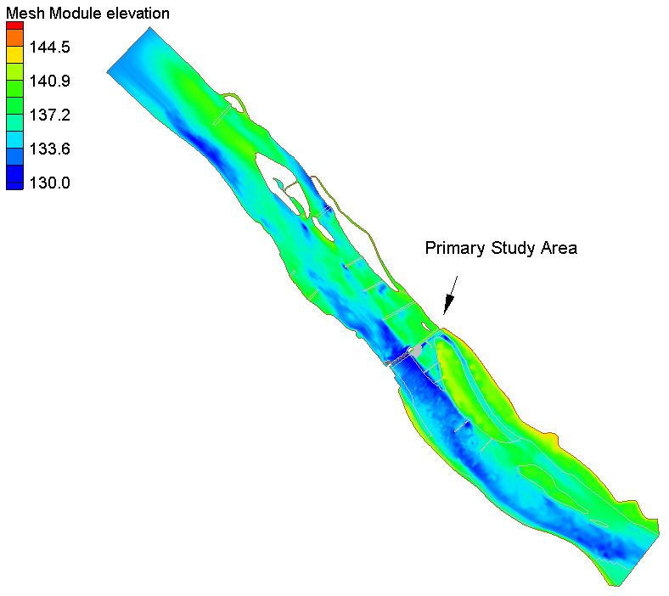
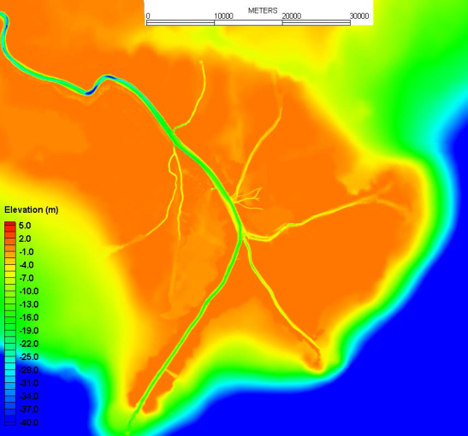
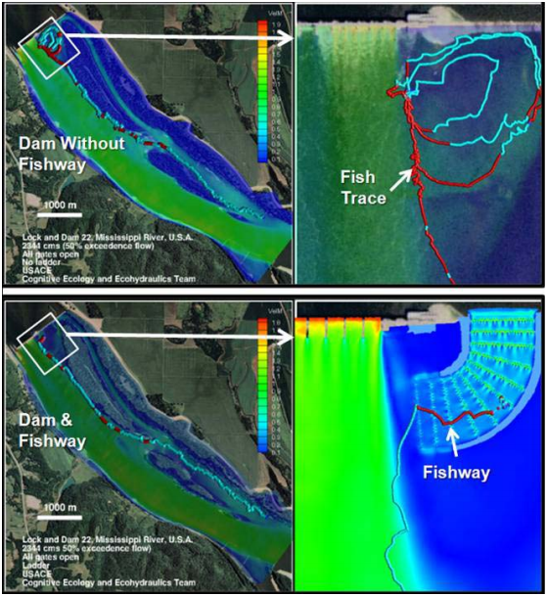
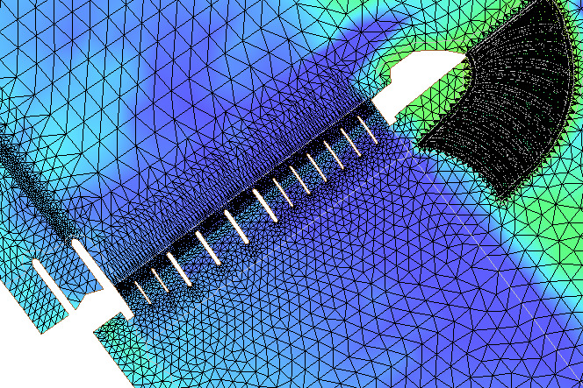
Environmental Modeling Challenges
Large domains to capture system behavior
Detailed resolution and physics needed for
engineering analysis
400 river miles from upstream of Old River Control to Gulf of Mexico
9.3+ million acres
100 m resolution in river
Base versus Plan Study for Fish Passage
Notes:
480,411 elements
245,465 nodes

Slide 7
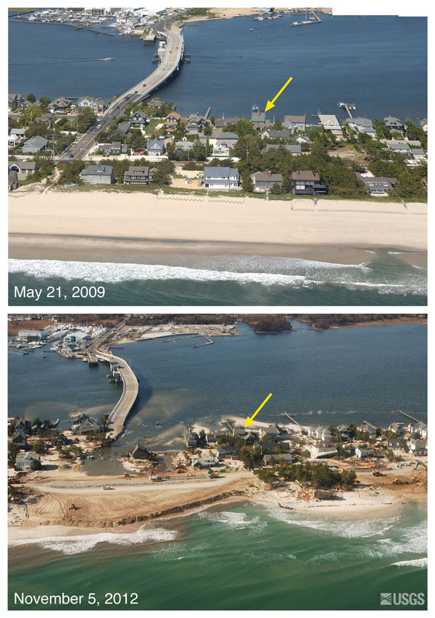
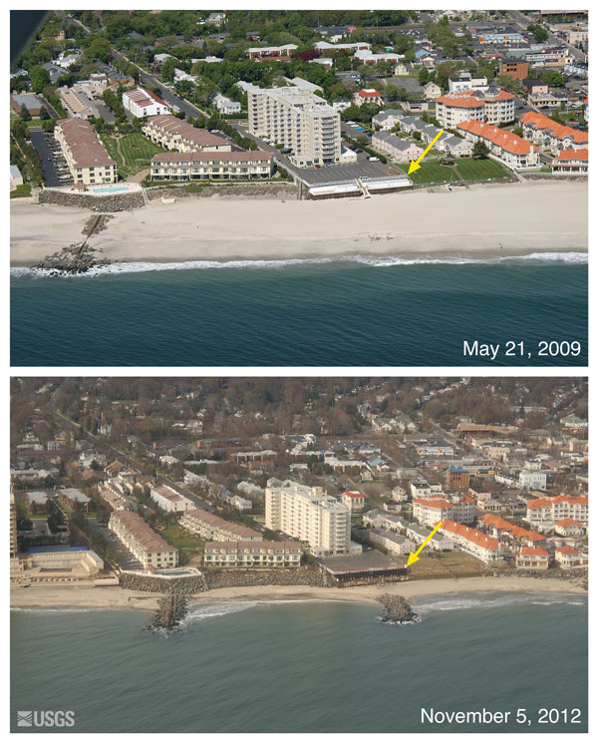
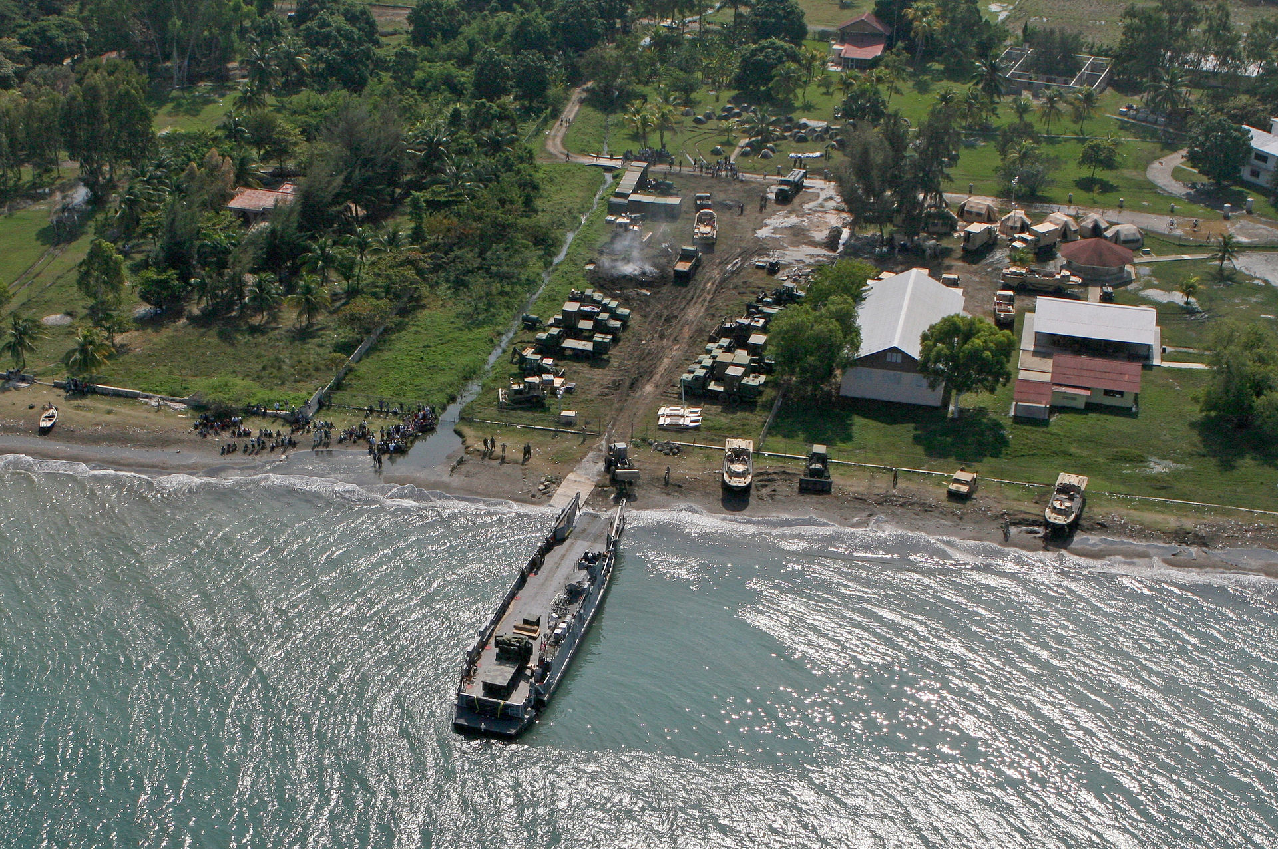
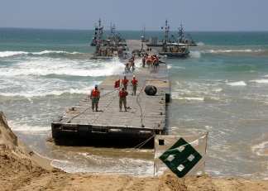
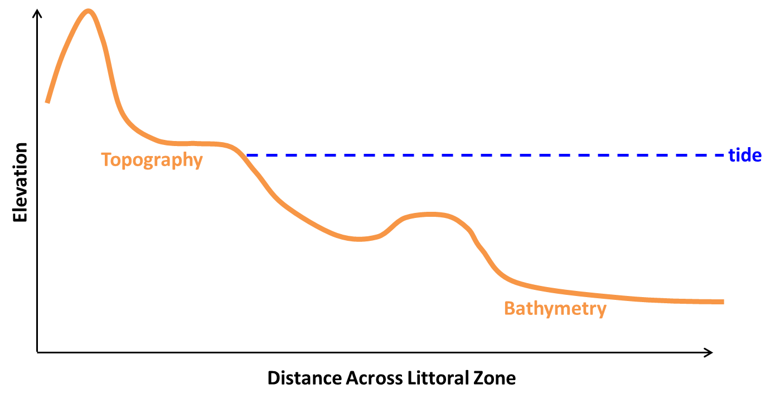
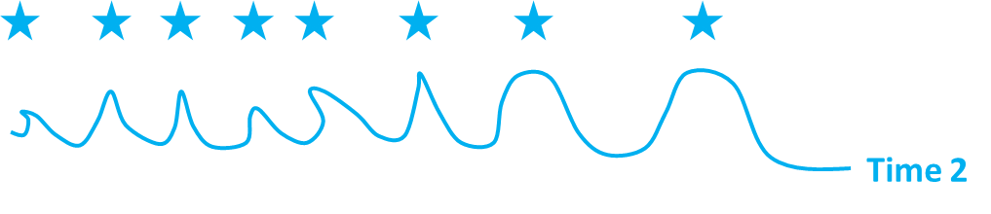
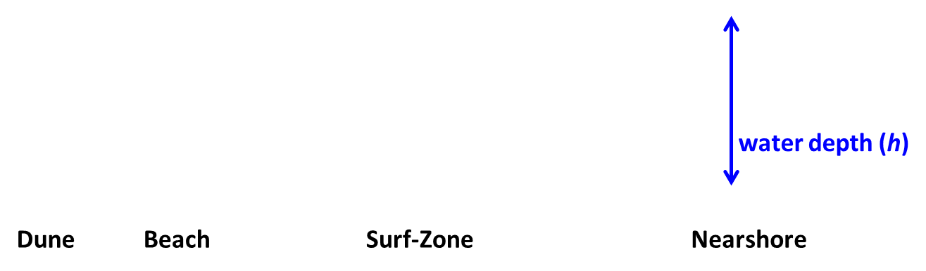
What Is the problem?
Logistics for Humanitarian Aid, Haiti 2010
Support for Nearshore Military Operations
Super-storm Sandy led to wide spread beach erosion from Virginia to New York.

Slide 8
What do we need to solve the problem?
Wave Action Balance Equation

Slide 9
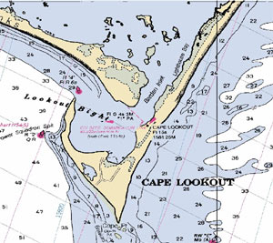
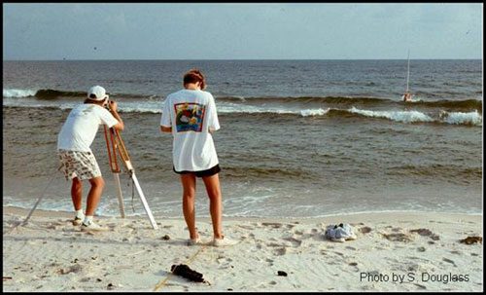
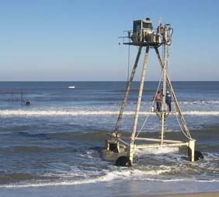
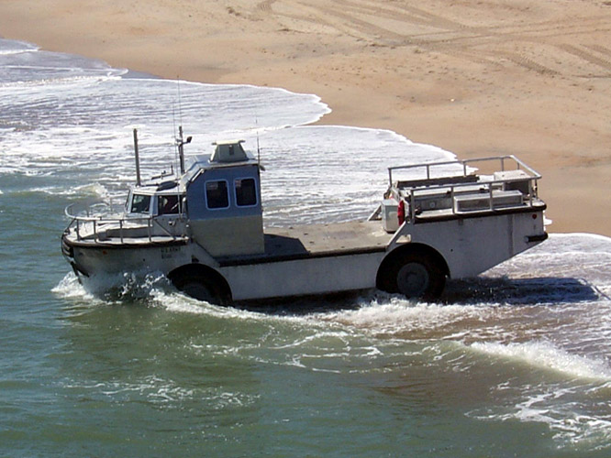
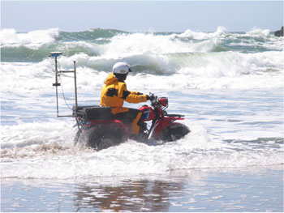
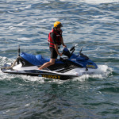
Measurement of Littoral Bathymetry
Nautical Charts
Rod and Level
Real Time Kinematic -Global Positioning System (RTK-GPS)
CRAB or LARC
Jet-ski, ATV, backpack
All are either not accurate, expensive, or only cover limited regions
Notes:
Need to add something about satellites, make more general

Slide 10
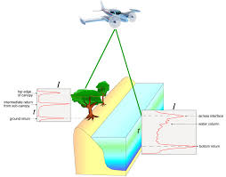
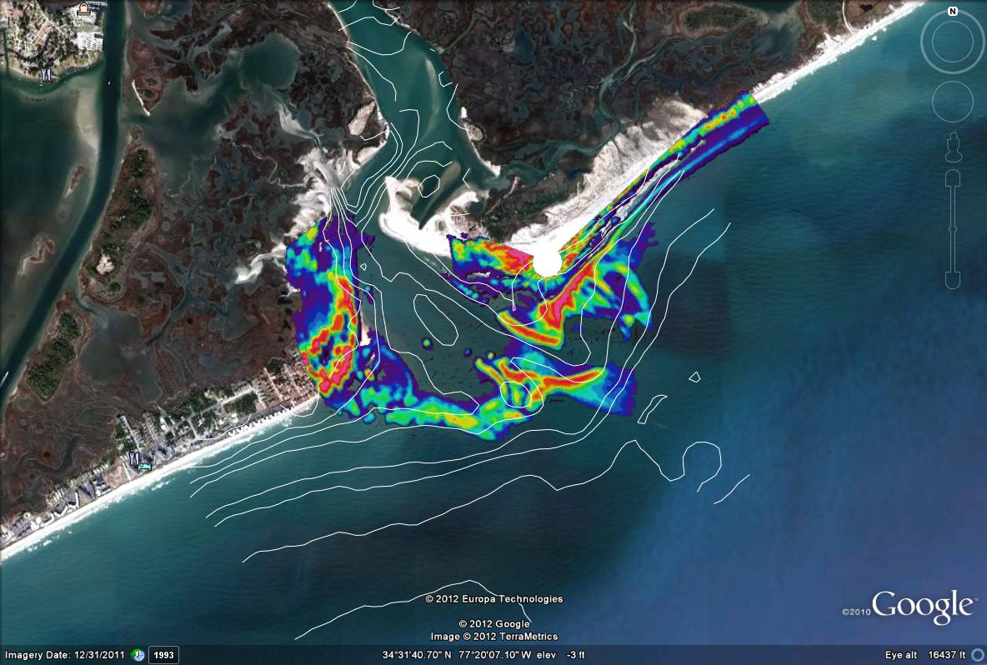
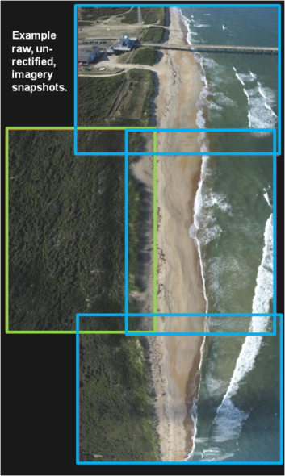
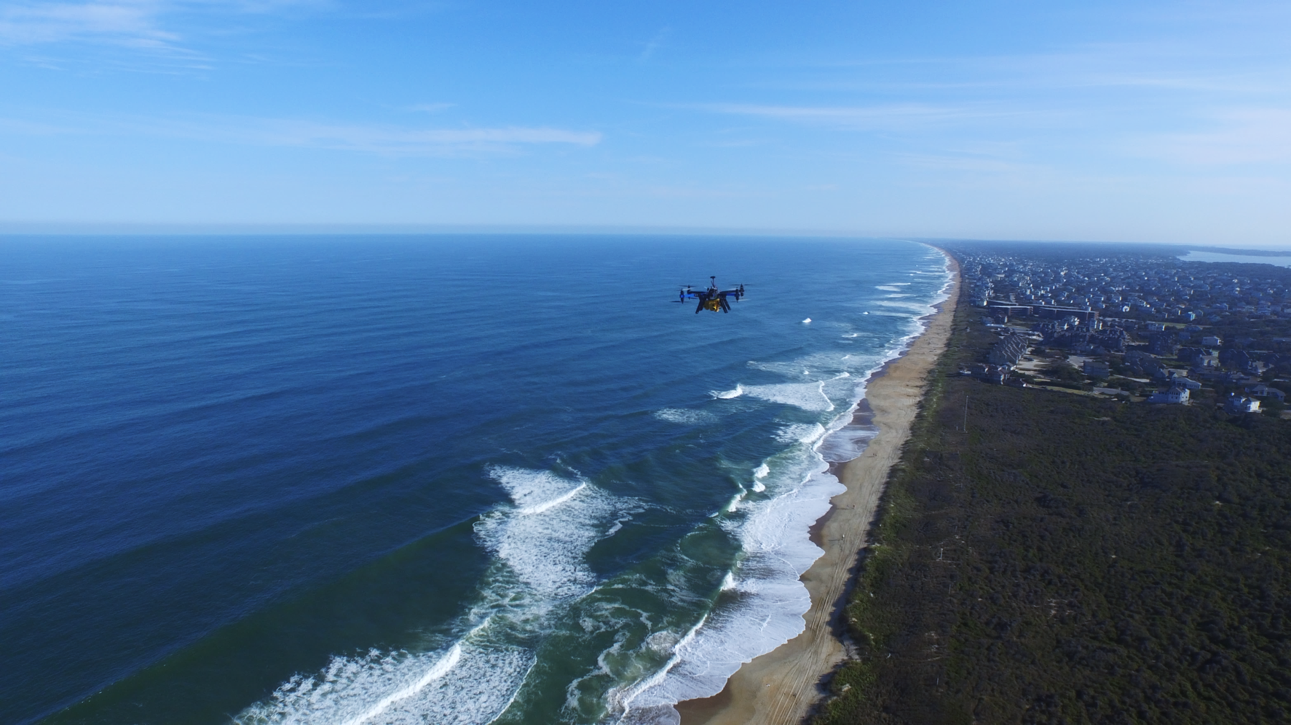
Sensing in the Littoral Zone
Surface wave characteristics and topography from mounted LiDAR and radar stations
Surface wave characteristics from photogrammetric and LIDAR airborne platforms (manned and unmanned vehicles)
Satellites
Notes:
Need to add something about satellites, make more general

Slide 11
What is the role of data assimilation with Nearshore remote sensing?
UAS technology provides a unique observation of the environment at a single time.
Lack of continuous observation reduce the accuracy of the inversion analysis
Higher fidelity physics can pull more out of observation data sets and improve prediction between observations

Slide 12
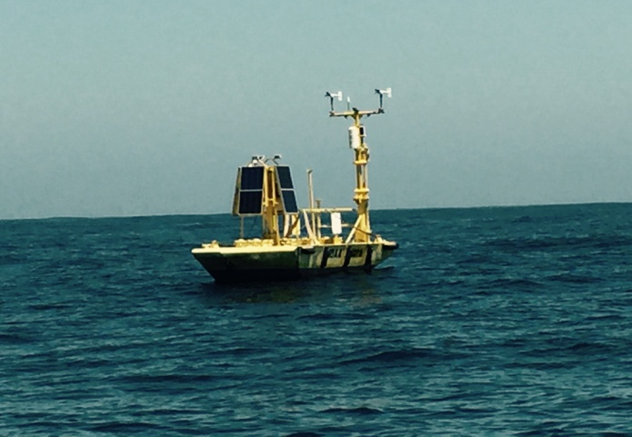
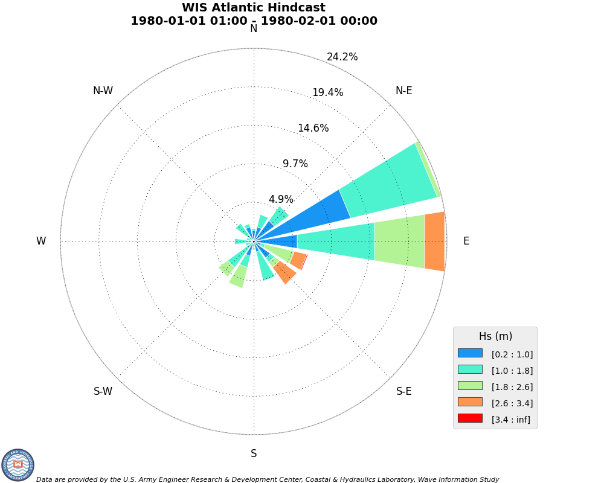
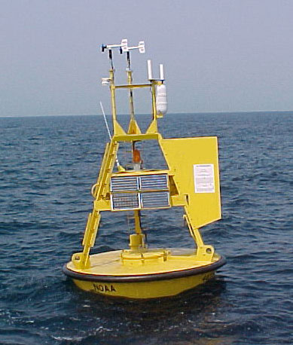



Model boundary conditions?
Nowcast and Hindcast
Deterministic wave model estimates provide the best guess of the past for a region
Wave Buoys provide in-situ estimates for a single point.
Model forecast provide prediction for a region
Forecast
Build local probabilistic prediction of wave conditions

Slide 13






What is the role of data assimilation for Hurricane Flood Risk?
Background Bathymetry
UAS Hurricane Season
Hurricane Forecast
Pre-Storm UAS
Hurricane
Model Risk Assessment
JALBTCX (1-2 yrs)
Post Storm Assessment
Data Assimilation coupled to CSTORM for flood risk prediction

Slide 14

Goals
We’d like to be able to estimate the bathymetry in natural environments when we direct measurement is difficult or very costly
We would like to use the inverted bathymetry to calculate surf zone characteristics in a short term forecast
We would like to provide sand bar location, beach slope, and wave breaking height and period with uncertainty.
Things we can explore
Model-based inversion
How do we solve the inverse problem?
How do we approximate the hydrodynamics?
Local wave boundary conditions
Access model forecasts/hindcasts and buoy measurements for forcing
Calculate localized stochastic model

Slide 15


What Needs To Be Done?
Requires modeling free-surface hydrodynamics, representation of bathymetric variability
Build method for calculating boundary conditions for model
Semi-analytical solutions for idealized examples to full numerical solution
Survey Data, Field Research Facility, Duck NC

Slide 16
Coastal engineering?

